Slide 1
Welcome to the 3rd Grade Lakewood Elementary

Slide 2
Meet the Teachers
Mrs. Courtney Anthony
Mrs. Farrah Baker
Mrs. Tracey Cutt
Ms. Susan Elkins

Slide 3
Report Cards and Testing
Every 9 weeks your child will be assessed on very specific standards.
Your child will receive a numeric grade for each subject area.
Grades will be composed from informal and formal assessments.
65% of the grade will be from formal assessments (unit tests).
25% of the grade will be from informal assessments (class work and projects).
10% of the grade will be from classroom participation and homework.

Slide 4
Reader’s Workshop
During this time, students will be moving through our Reading Wonder’s series.
This series integrates phonics and writing, along with science and social studies.
The series is broken down into 6 units. Each unit has about 5 weeks.
At the end of each week, students will have an assessment that will count towards their reading and language arts grade.

Slide 5
Reader’s Workshop
Centered Groups:
Guided reading
Computer center (AR)
Interactive notebooks
Student led Your Turn book and tasks cards.

Slide 6
Writer's Workshop
Writing is built into the Reading Wonder’s series.
Types of writing your child will learn this year
Narrative
Informational
Explanatory
Opinion

Slide 7
Testing
STAR reading and math (Quarterly)
Reading Dibels (monitored throughout the year).
End of the year performance series.

Slide 8
Wonders Home Connect
The Connect Ed portion allows students/parents to access all reading materials from the internet.
Students can practice skills, read selections, and locate homework.

Slide 9
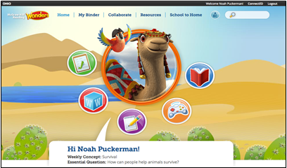
Exploring the Student Workspace
Top Navigation:
Home screen
My Binder – area for students to save work
Collaborate – teacher moderated area for discussion and inquiry projects
Resources – a complete listing of student resources
School to Home – parent letters, activities and suggestions for home practice
ABC – Complete grade level, visual vocabulary

Slide 10
Fast Launch Icons

Slide 11
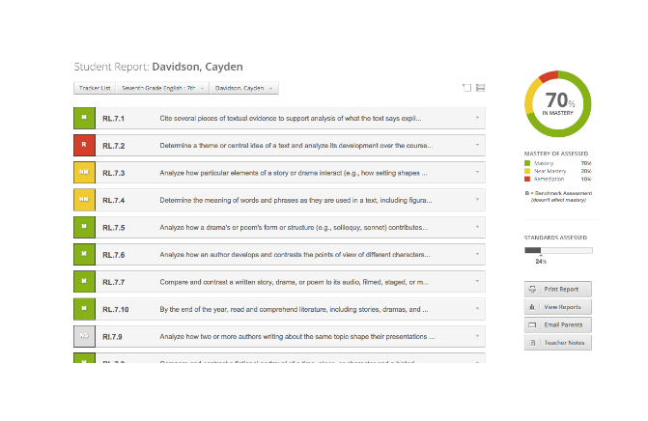
Mastery Connect

Slide 12
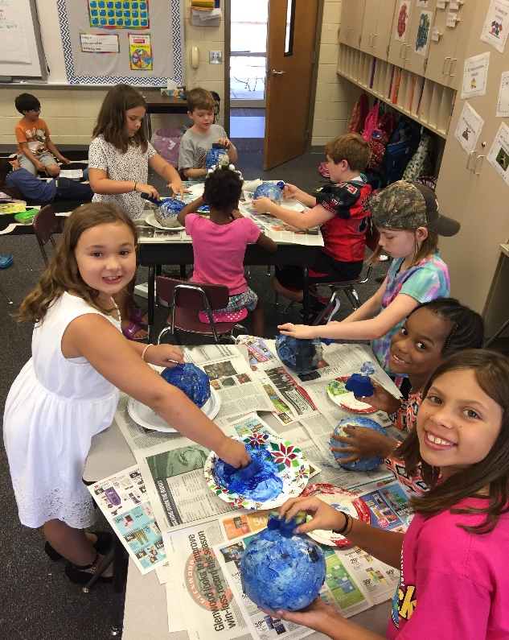
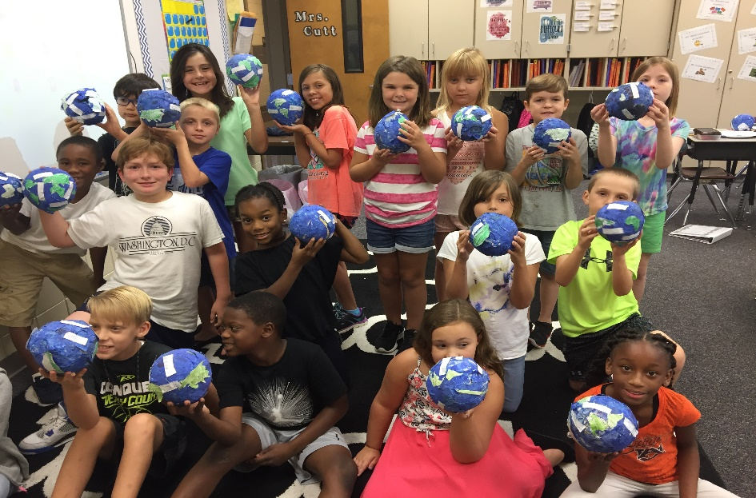
Social Studies
Through out the year we will be doing a variety of activities such as map skills, landforms, environment features and natural disasters, needs versus wants, trade patterns, and geographic features of Alabama.

